Slide 1

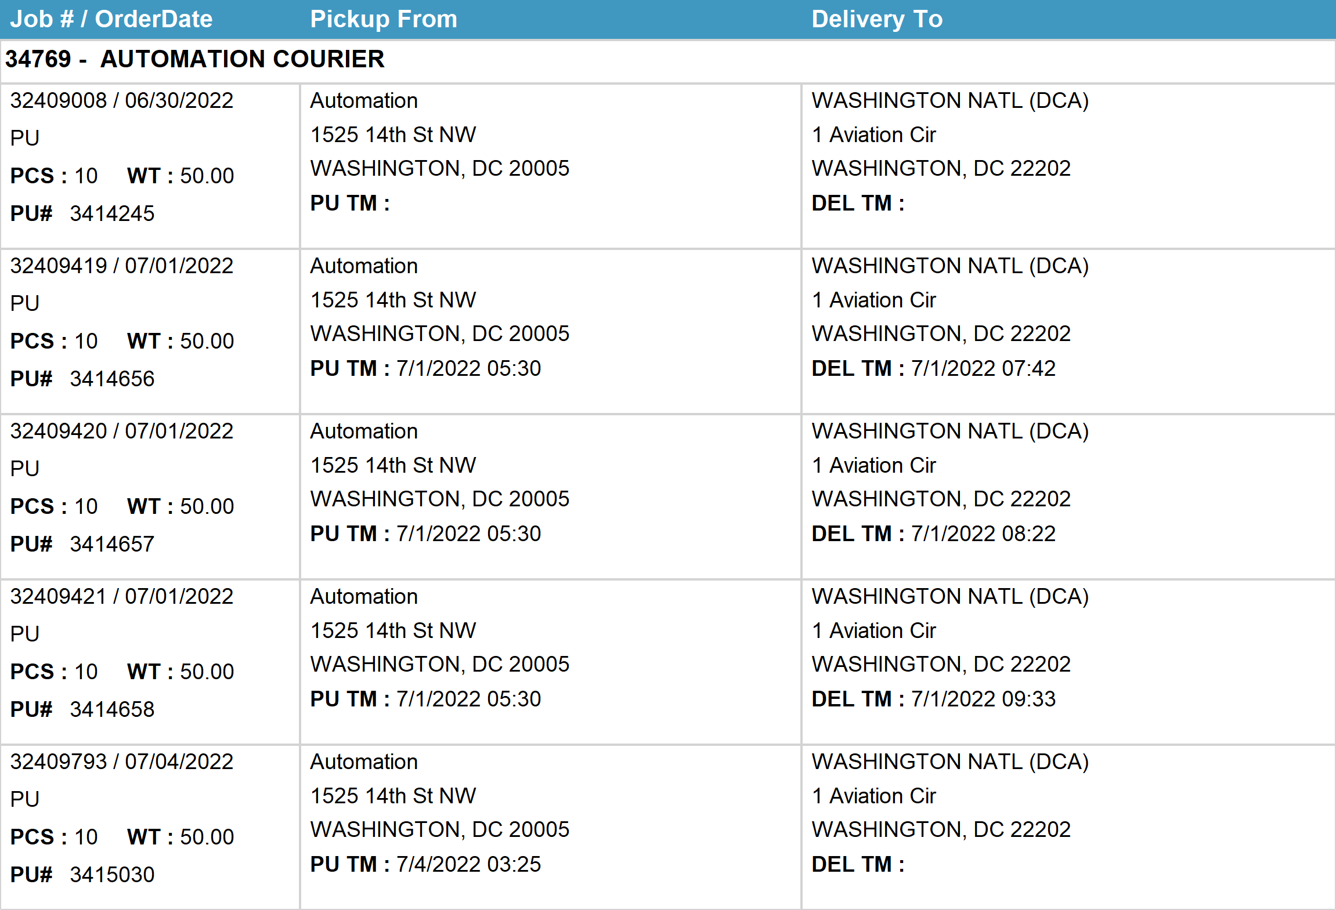
Agent Activity Report
*Data provided should be considered CONFIDENTIAL and PROPRIETARY*
©2011-2022 MNX Global Logistics. All rights reserved.
7/6/2022 11:15 PM
Print User : automation

Slide 2
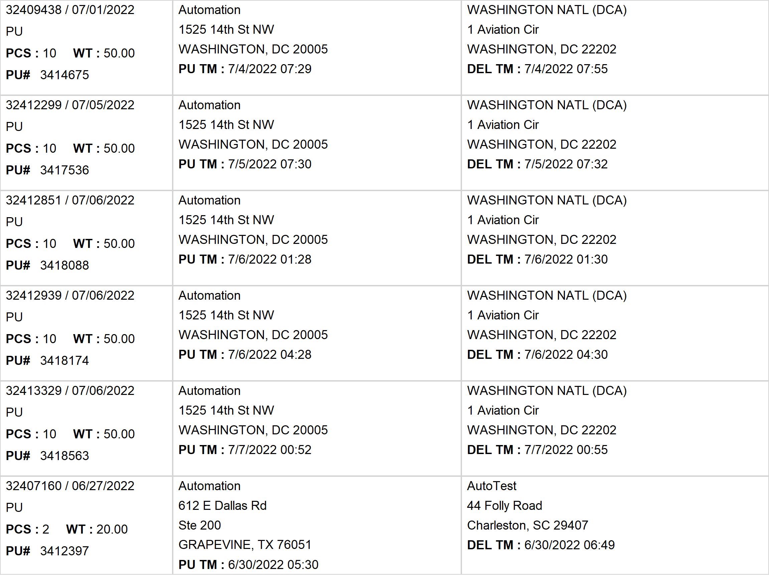
Agent Activity Report
*Data provided should be considered CONFIDENTIAL and PROPRIETARY*
©2011-2022 MNX Global Logistics. All rights reserved.
7/6/2022 11:15 PM
Print User : automation

Slide 3
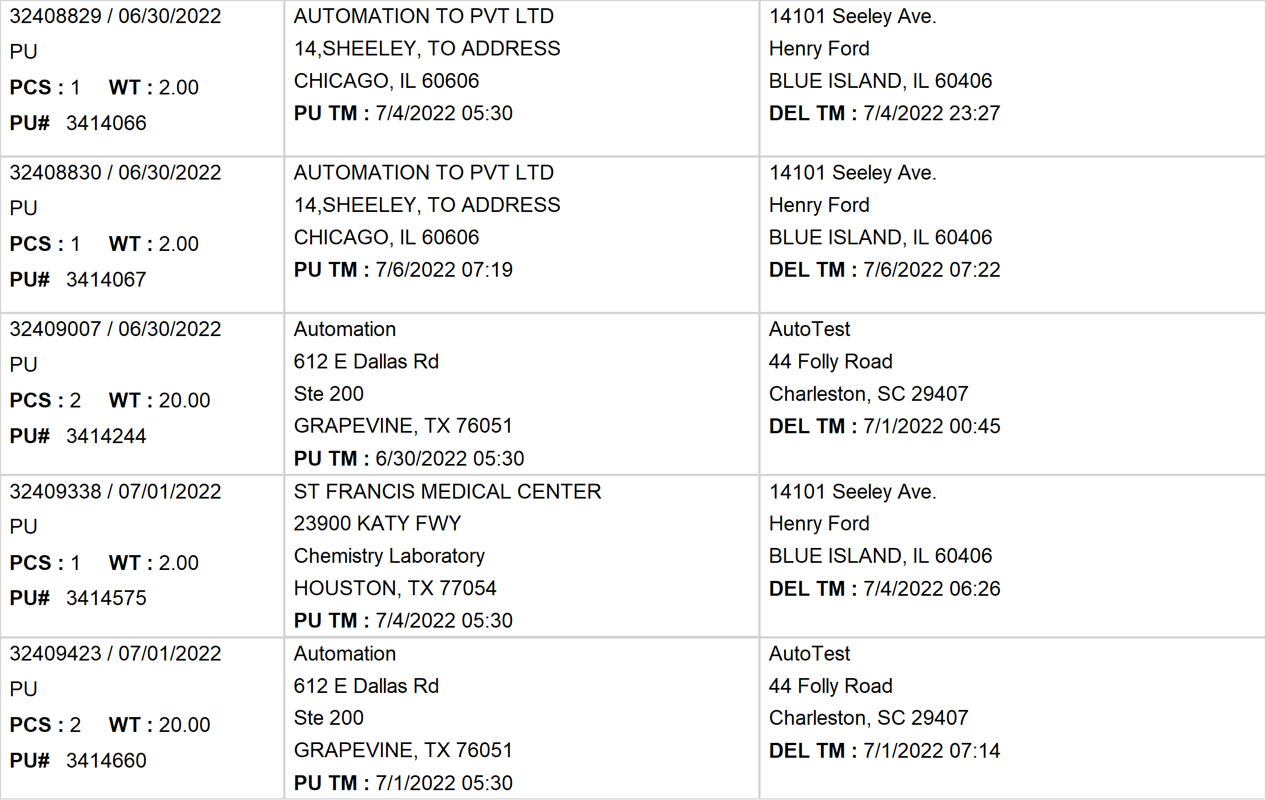
Agent Activity Report
*Data provided should be considered CONFIDENTIAL and PROPRIETARY*
©2011-2022 MNX Global Logistics. All rights reserved.
7/6/2022 11:15 PM
Print User : automation

Slide 4
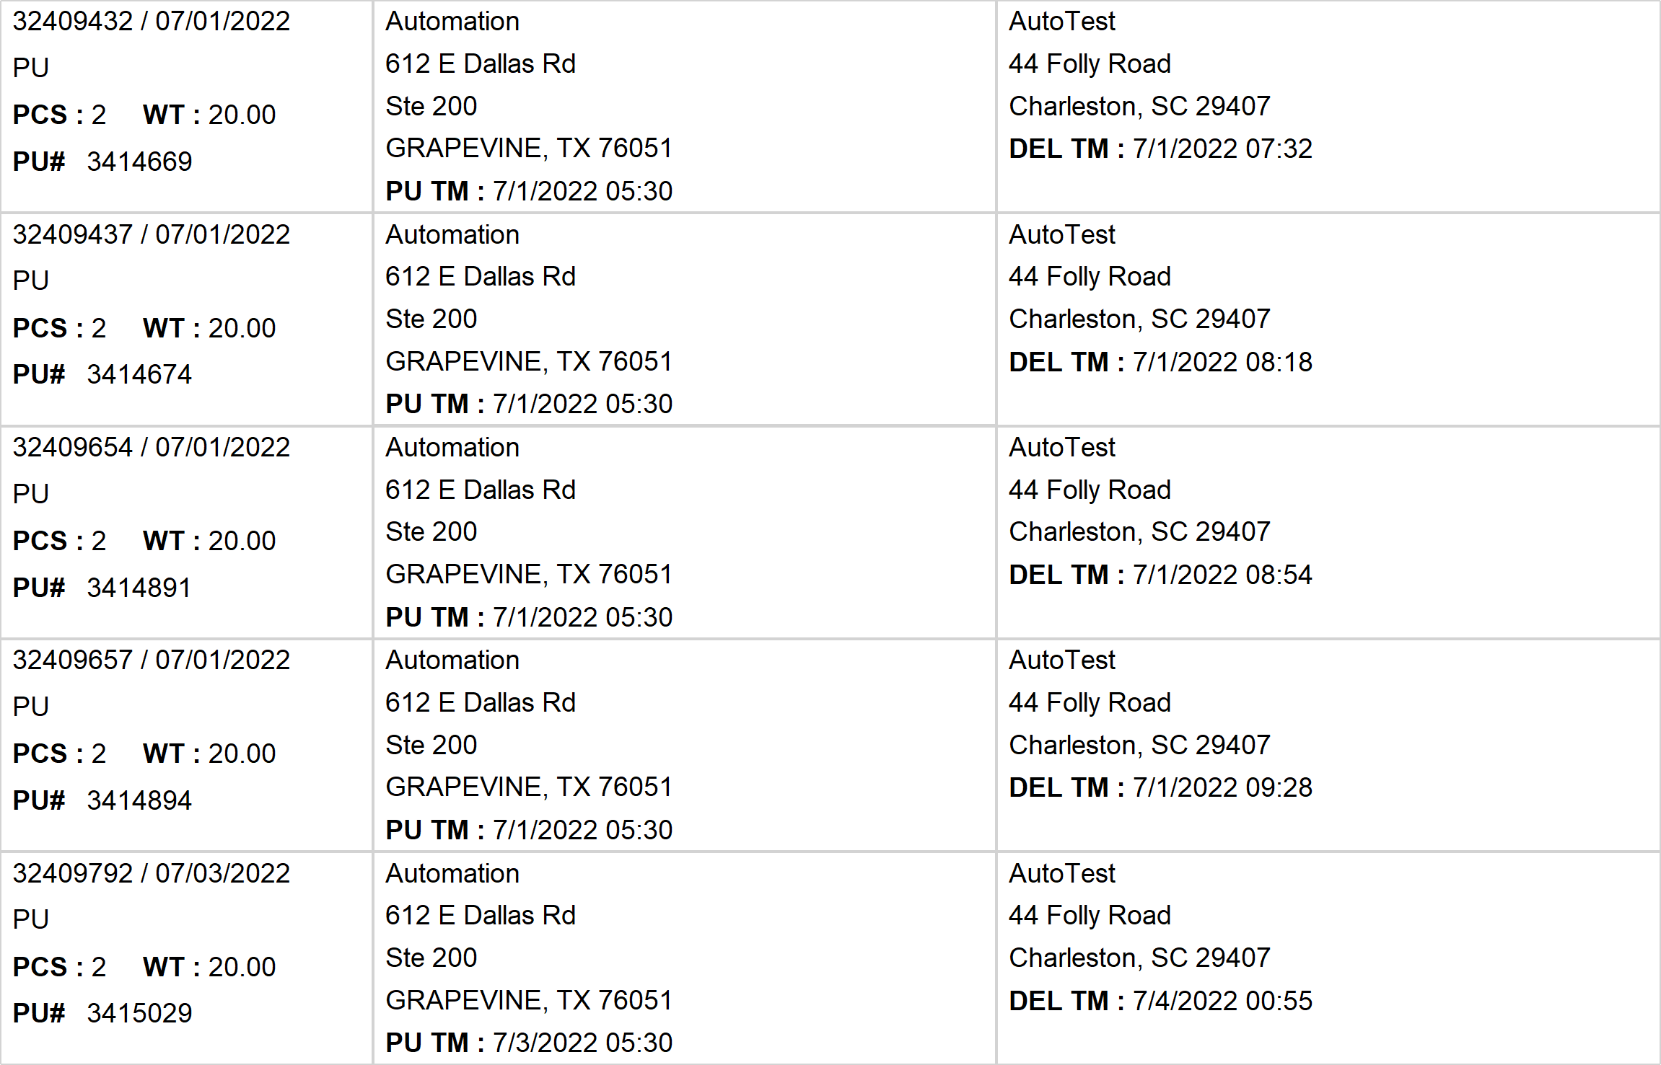
Agent Activity Report
*Data provided should be considered CONFIDENTIAL and PROPRIETARY*
©2011-2022 MNX Global Logistics. All rights reserved.
7/6/2022 11:15 PM
Print User : automation

Slide 5
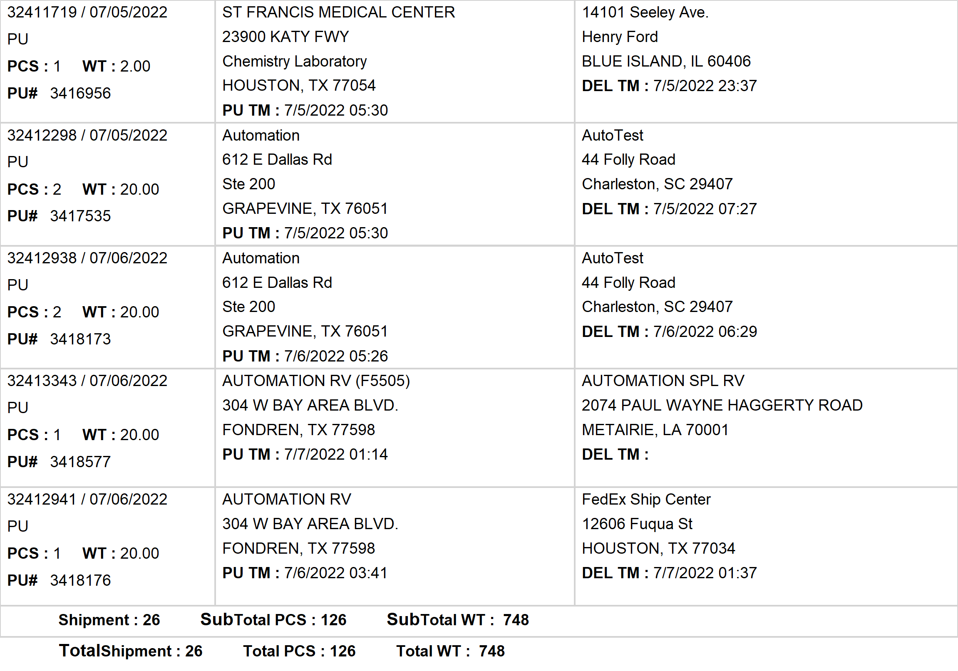
Agent Activity Report
*Data provided should be considered CONFIDENTIAL and PROPRIETARY*
©2011-2022 MNX Global Logistics. All rights reserved.
7/6/2022 11:15 PM
Print User : automation

Slide 6
Agent Activity Report
*Data provided should be considered CONFIDENTIAL and PROPRIETARY*
©2011-2022 MNX Global Logistics. All rights reserved.
7/6/2022 11:15 PM
Print User : automation

